Slide 1
Animations Workshop
STANFORD | CODE IN PLACE
Hosted by HTA Ngoc

Slide 2
Type your favorite animated film or show!

Slide 3
TABLE OF CONTENTS
01.
02.
INTRODUCTION
EXAMPLES
03.
04.
GRAPHICS + TOOLS
PRACTICE
Today’s Goals + Content Review
Previous Final Projects
Let’s Practice
Let’s Practice

Slide 4
01.
Introduction
Today’s Goals + Content Review

Slide 5
Goal Today
We have mastered making static / “still” shapes and pictures… how can we animate them?
Shapes
Imported Images
Gaining inspiration for final projects
Physics-based / simulation-based
Game-based
Maybe you want to make an animated story of sorts!

Slide 6
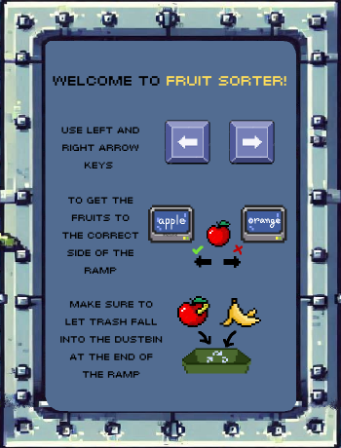
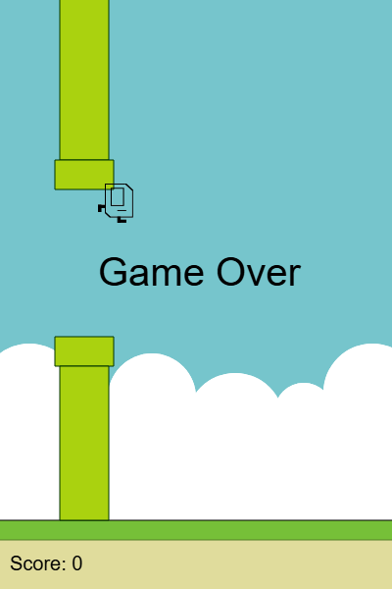
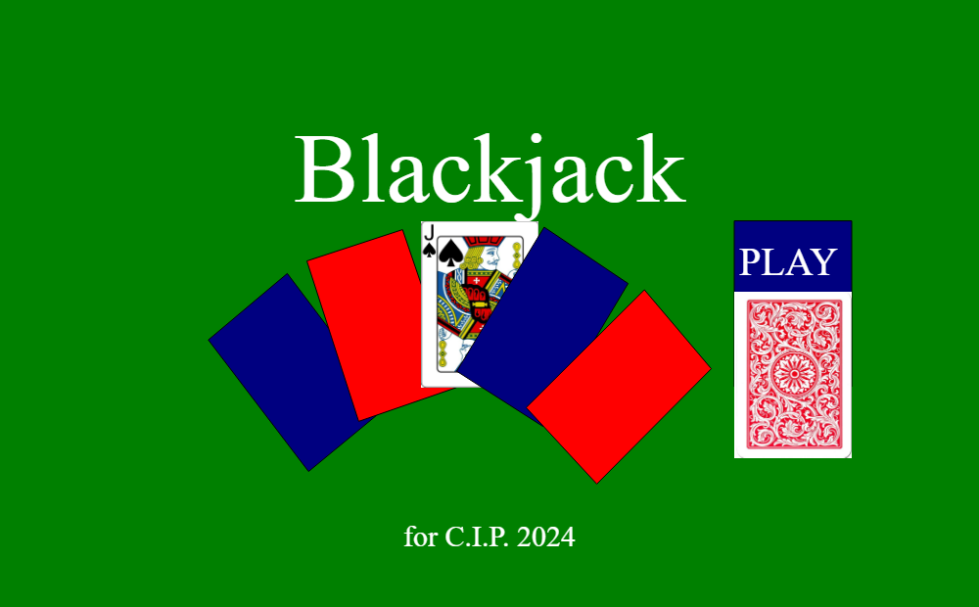
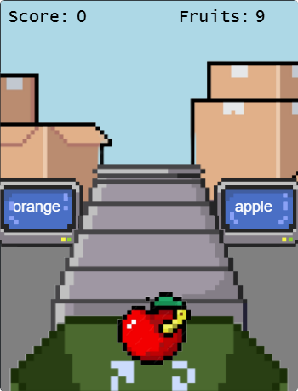
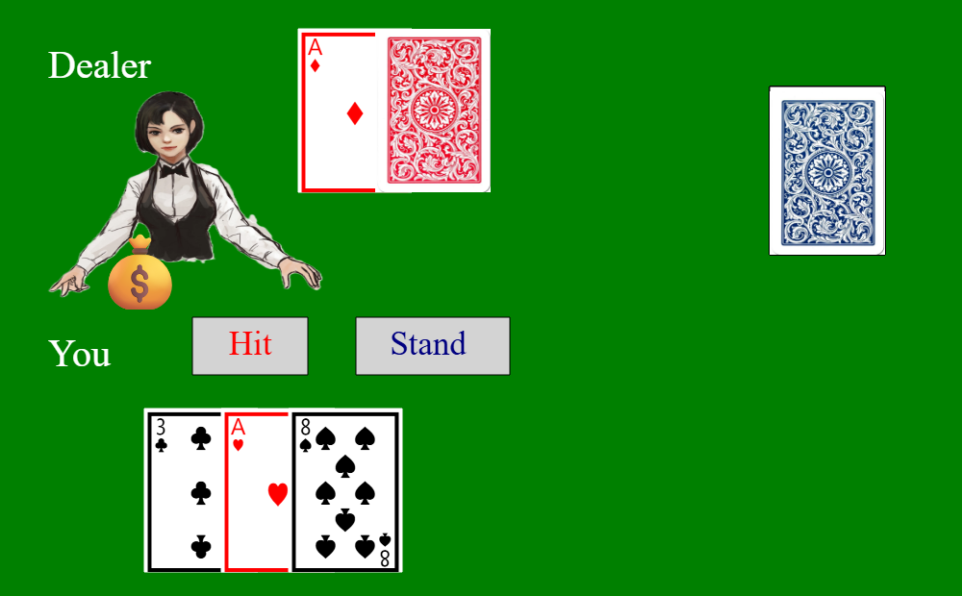
Last time, we looked at some game projects! These have animations:
Fruit Sorter by Lubaba H
Blackjack by Aslihan T
Flappy Karel by Ken T

Slide 7
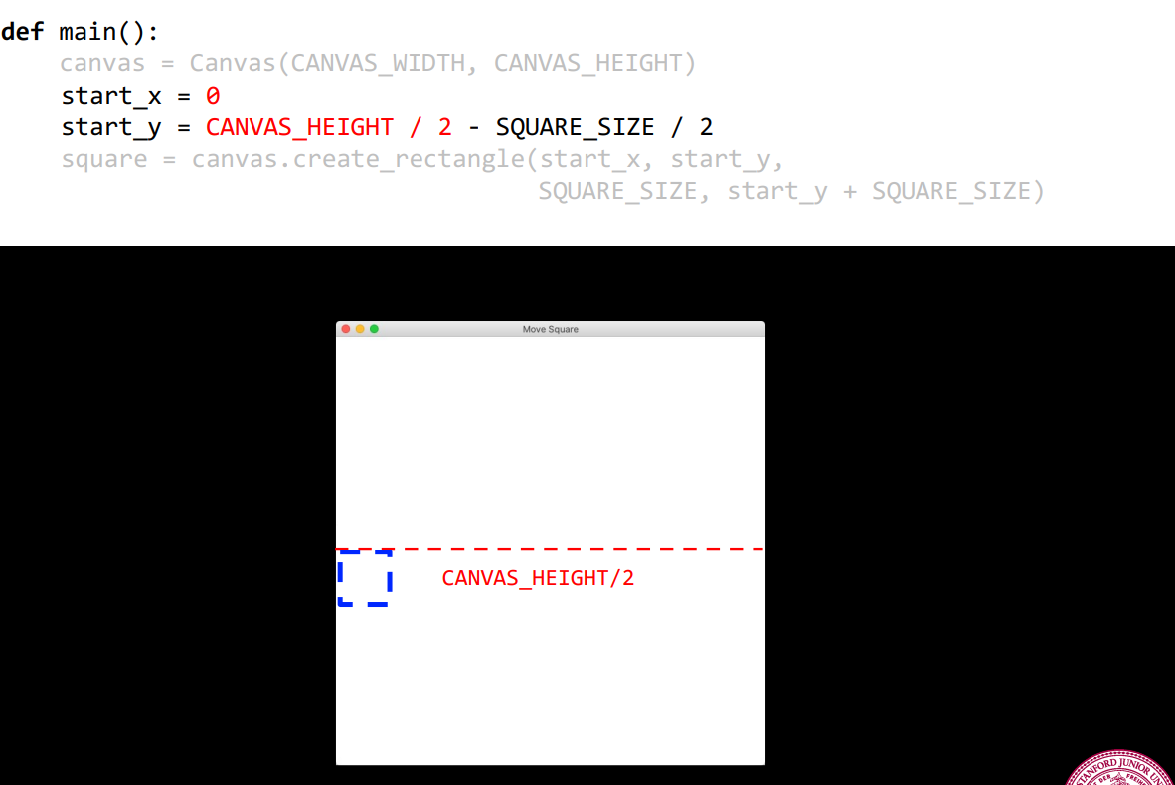
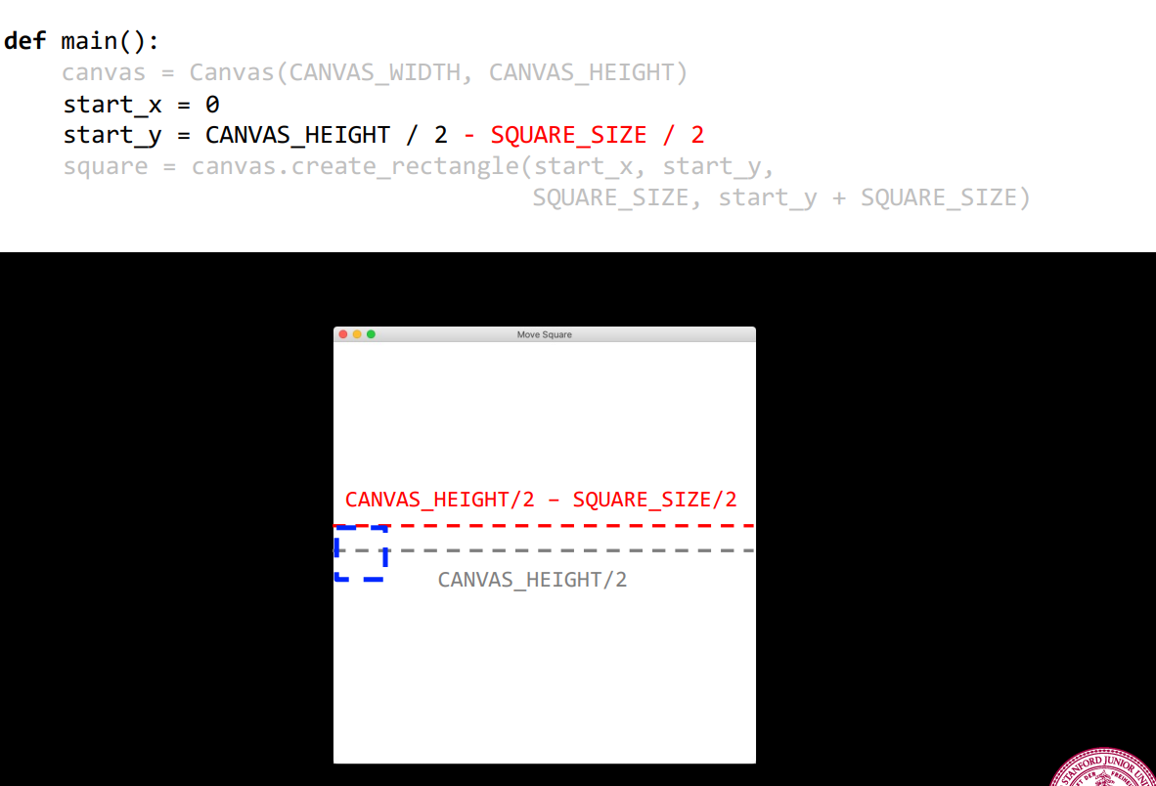
NOTE: Shapes start at the top left corner!

Slide 8
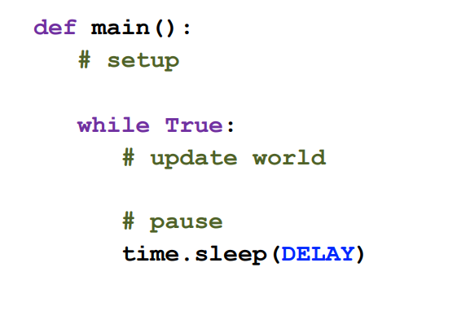
The General Layout of Animation / Game Projects
variables + canvas set up
continuous animation loop of heartbeats or “frames”
a pause between these frames

Slide 9
02.
Animations Examples
Previous Final Projects from CIP4 / CIP3

Slide 10
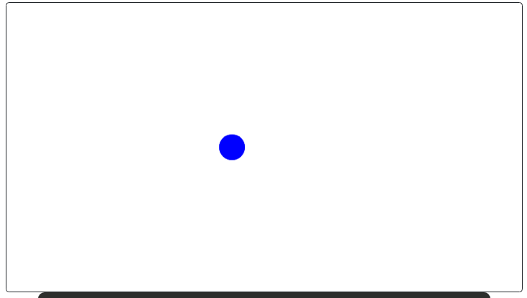
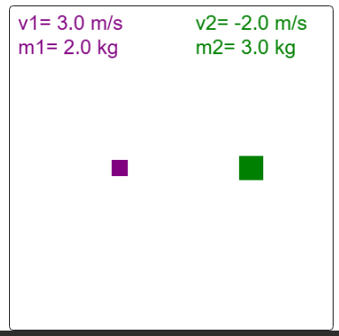
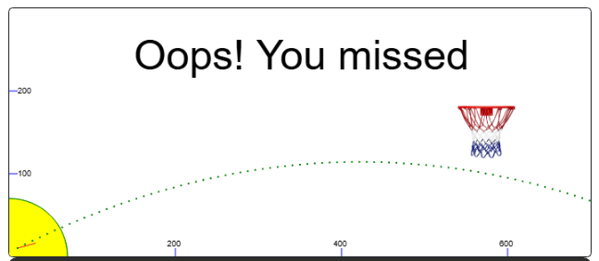
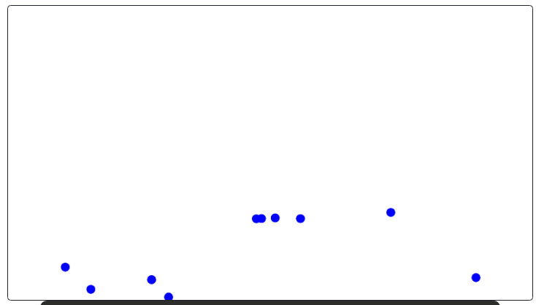
Exploding Ball by Dave N
Collision Simulator by Nicolás P
Projectile Game by Jimmy C

Slide 11
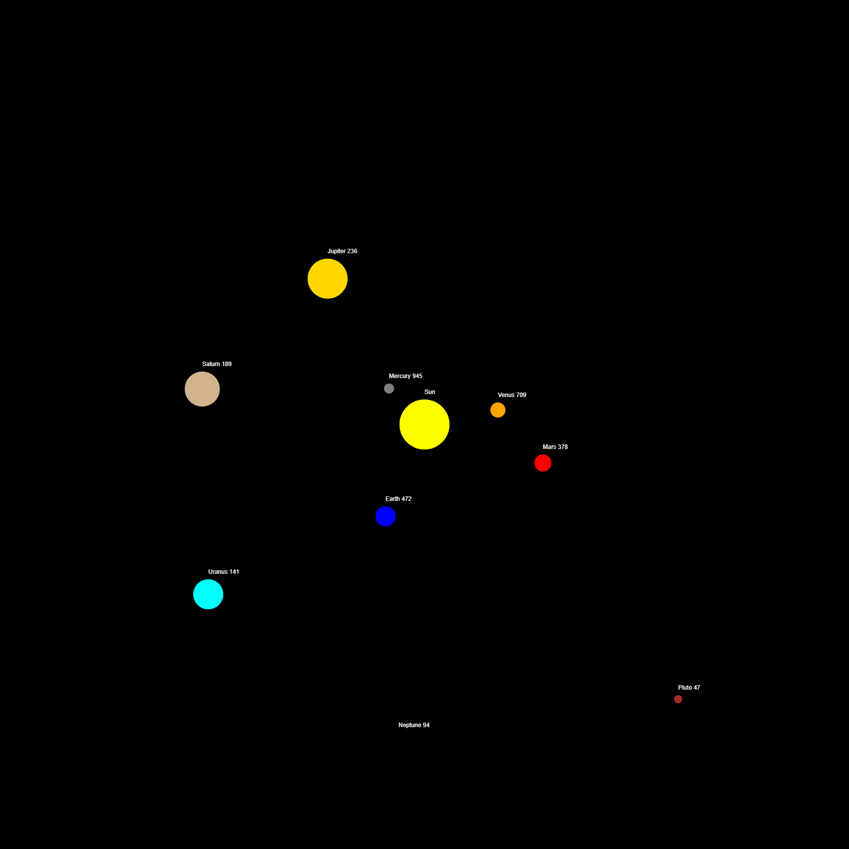
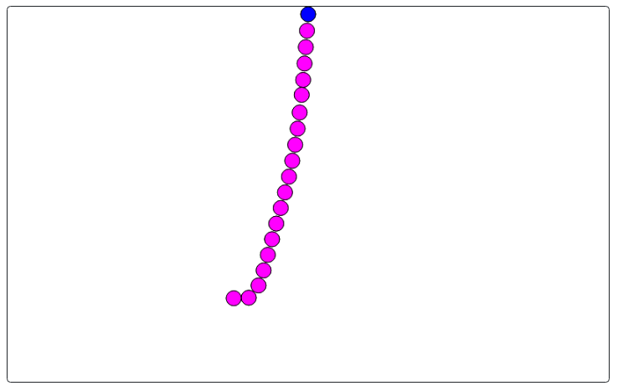
Solar System Simulator by SK. S
Iron Ball Chain by Jimmy C

Slide 12
03.
Graphics Library
Short Review & Toolbox

Slide 13
Quick Review About Graphics Library
What is graphics capable of doing?
Making a canvas of different sizes → like a game window!
Shapes
Rectangles
Circles
Polygons (including triangles)
Lines
Text
Images
Tracking user input
Clicks
Mouse Movements
Keyboard Buttons
Setting and getting properties of shapes and objects
Check out the documentation within the IDE of graphics projects!

Slide 14
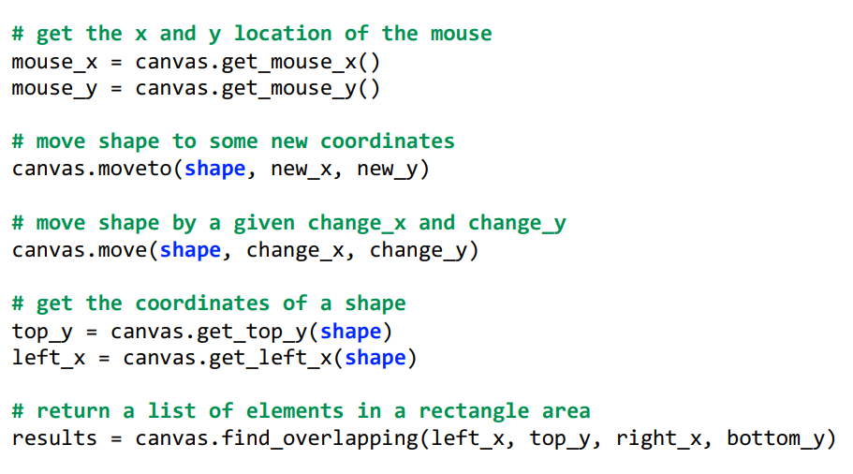
Special Graphics Functions

Slide 15

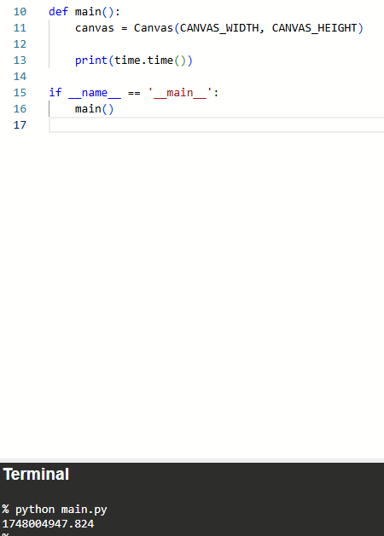
Other Useful Built-In Python Libraries
Library - a collection of prewritten code and functions that you can import and use
Random
import random
random.randint(1, 10) → returns an int from 1-10 inclusive
random.choice(list) → return an item from list
Time
import time
time.time() → returns time in epoch
time.sleep(x) → pauses your entire code for x seconds
Math
import math
Look here for doc

Slide 16
04.
Let’s Practice
Feel free to follow along on your own IDE!

Slide 17
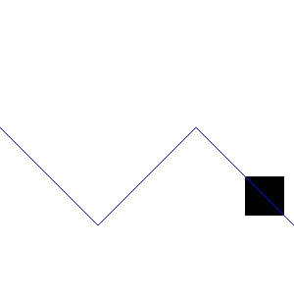
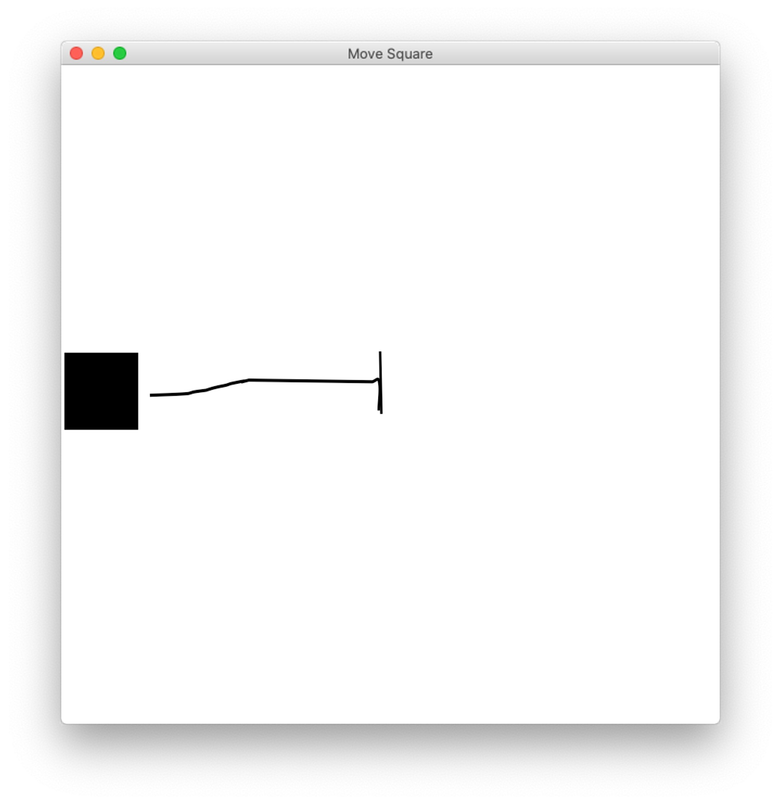
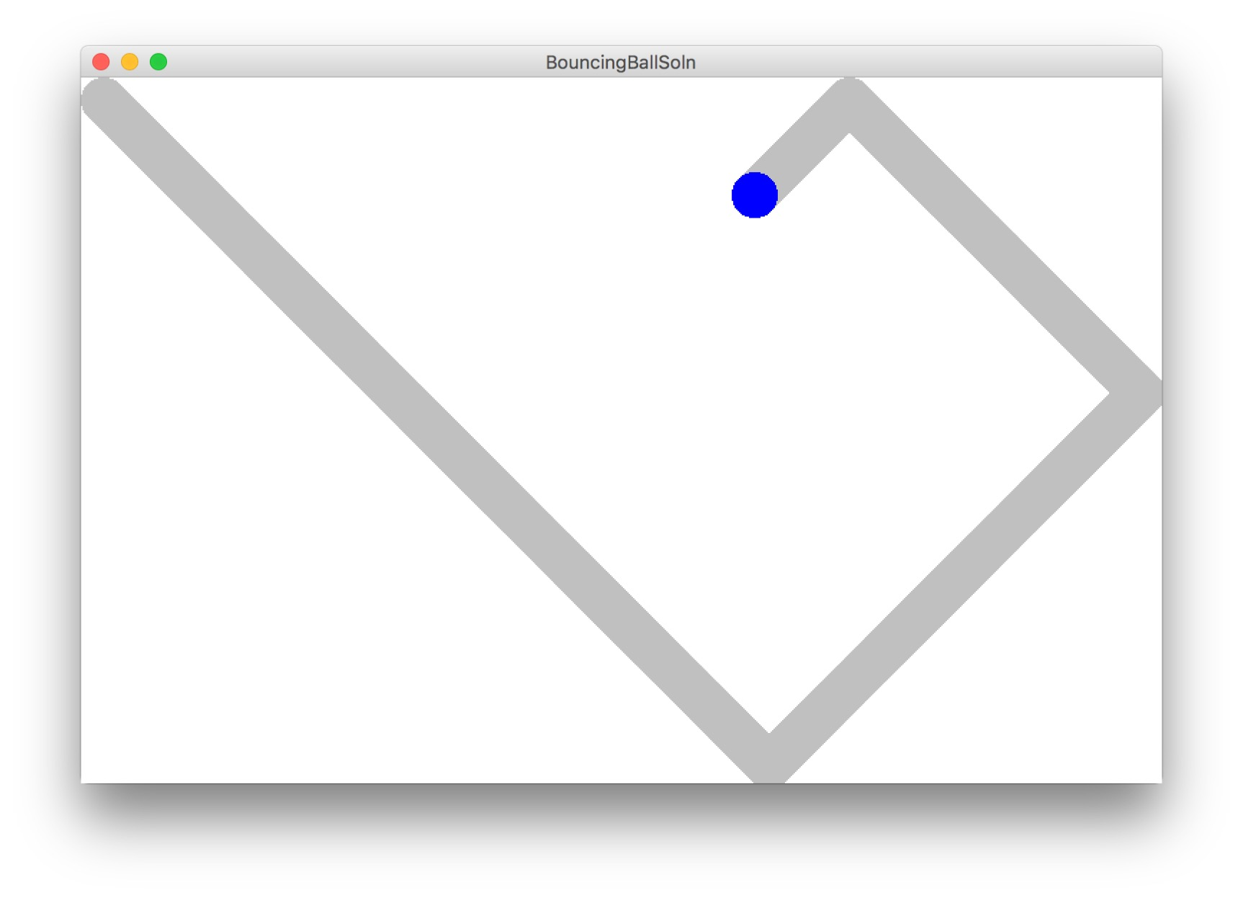
Moving Square
Bouncing Ball
Zig Zag

Slide 18

How do we change backgrounds + images to animate?

Slide 19
Q&A
Questions?

Slide 20
THANK YOU & HAPPY CODING!

